Slide 1
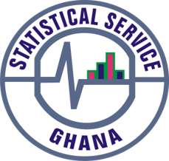
PRESS RELEASE
GHANA, APRIL 2022
CONSUMER PRICE INDEX AND INFLATION
11th May 2022

Slide 2
In this release, we present:
Definition and Measurement of Consumer Price Index (CPI) and Rate of Inflation
CPI and Rate of Inflation for April 2022
Dominant Divisions of Rate of Inflation for April 2022
Disaggregation of Rate of Inflation for April 2022
Highlights of CPI and Rate of Inflation for April 2022

Slide 3
Definition and measurement of CPI and rate of inflation (1/3)
CPI measures changes in the price of a fixed basket of goods and services purchased by households
The assumption is that the basket is purchased each month, hence as price changes each month, the total price of the basket will also change
The rate of inflation is the relative change in CPI between periods
Inflation is reported year-on-year (annual inflation) and month-on-month (monthly inflation), and granulated to determine regional and commodity type and source of inflation
2
2

Slide 4
Definition and measurement of CPI and rate of inflation (2/3)
CPI does not measure price levels
CPI is a price perspective measure and cost-of-living index is an expenditure oriented measure
Data (market readings) are captured monthly
Key variables are prices, quantities and expenditure weights of items
Price reference year is 2018 (2018 = 100)
3

Slide 5
Definition and measurement of CPI and rate of inflation (3/3)
Prices are collected for approximately 39,500 products every month.
Price collection is done in 44 markets
Prices are collected from 7,726 outlets.
Products are ordered in a hierarchy of 13 Divisions, 44 Groups, 98 Classes, 156 Subclasses and 307 Items.
Every Item can only be part of one Subclass, and every Subclass can only be part of one Class, etc.
4

Slide 6
Consumer Price Index and Rate of Inflation for April. 2022
CPI for April 2022 was 156.5 relative to 126.6 in April 2021
Year-on-year inflation rate for April 2022 was 23.6%
This means that in the month of April 2022 the general price level was 23.6% higher than in April 2021
Month-on-month inflation between March 2022 and April 2022 was 5.1%
Month | CPI | Inflation |  | Quarterly Averages
 |  | Monthly | Yearly | Quarterly Averages
Mar-2021 | 124.7 | 0.9% | 10.3%
Apr-2021 | 126.6 | 1.5% | 8.5% | Q2: 7.9%
May-2021 | 127.6 | 0.8% | 7.5%
June-2021 | 129.2 | 1.3% | 7.8%
Jul-2021 | 131.3 | 1.6% | 9.0% | Q3: 9.8%
Aug-2021 | 131.7 | 0.3% | 9.7%
Sept-2021 | 132.5 | 0.6% | 10.6%
Oct-2021 | 133.3 | 0.6% | 11.0% | Q4: 11.9%
Nov-2021 | 135.2 | 1.4% | 12.2%
Dec-2021 | 136.9 | 1.2% | 12.6%
Jan-2022 | 139.7 | 2.1% | 13.9% | Q1: 16.3%
Feb-2022 | 143.0 | 2.4% | 15.7%
Mar-2022 | 148.8 | 4.0% | 19.4%
Apr-2022 | 156.5 | 5.1% | 23.6%
5
Notes:
In April 2022, year-on-Year inflation increases by 4.2 percentage points (from 19.4% to 23.6%) and Month-on-Month inflation surges up by 1.1 percentage points (from 4.0% to 5.1%).
In the first quarter of 2022, the average inflation was 16.3%, relative to 10.2% recorded for the same period in 2021.

Slide 7
Disaggregation of April 2022 rate of inflation
Food inflation was 26.6%
Last month this was 22.4%
Average over last 12 month was 13.5%
Month-on-month Food inflation was 5.8%.
Non-food Inflation was 21.3%
Last month this was 17.0 %
Average over last 12 month was 12.2%
Month-on-month Non-Food inflation was 4.6%
Inflation for locally produced items was 23.0%
Inflation for imported items was 24.7%
6
Notes:
The margins between food and non-food inflation remains about the same for March (5.4 percentage points) and April (5.3 percentage points), 2022
For both food and non-food inflation the variation between April 2022 and the rolling average from May 2021 to April 2022 is about two-fold.
The margin between month-on-month food and non-food is 1.2 percentage points for April 2022
For the first time since the rebasing of inflation in August 2019, imported inflation surpasses domestic inflation with a margin of 1.7 percentage points

Slide 8
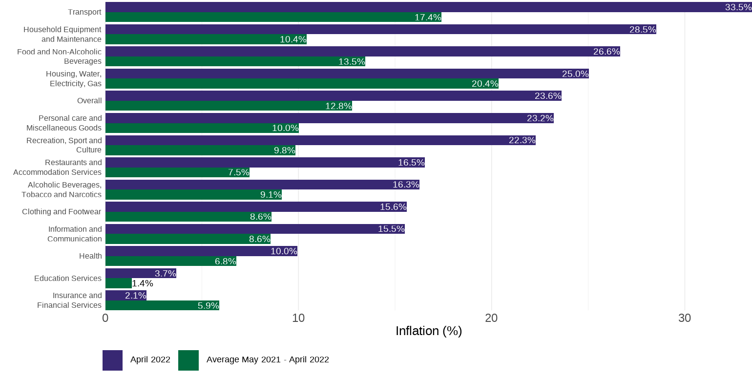
Disaggregation of year-on-year inflation by Division
7
Notes:
For the first time since the rebasing of inflation in August 2019, Household Equipment and Maintenance (28.5%), joins Transport (33.5%), Food and Non-Alcoholic Beverages (26.6%) and Housing, Water, Gas and Electricity(25.0%) to record rates higher than the national average (23.6%).
About nine of the thirteen divisions record have April inflation rates being about twice the rolling average from May 2021 to April 2022
Insurance and Financial Services is the only division that recorded an inflation rate for April 2022 that is lower that the rolling average for the period May 2021 to April 2022

Slide 9
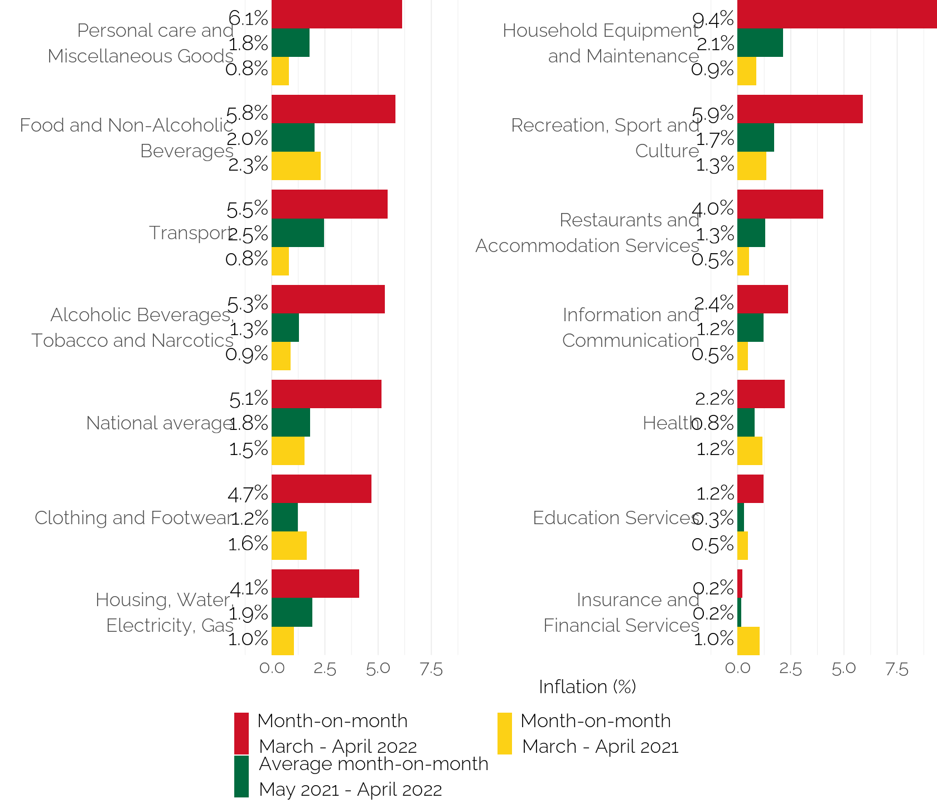
Disaggregation of month-on-month inflation
Notes:
On a month-on-month basis for April 2022, four divisions (personal Care and Miscellaneous Goods (6.1%), Food and Non-Alcoholic Beverages(5.8%), Transport (5.3%) and Alcoholic Beverages, Tobacco and Narcotics (5.3%), record inflation rates higher than the national average (5.1%).
Insurance and Financial Services on a month-on-month basis is the only division that recorded an inflation rate for April 2022 that is lower than the March 2022

Slide 10
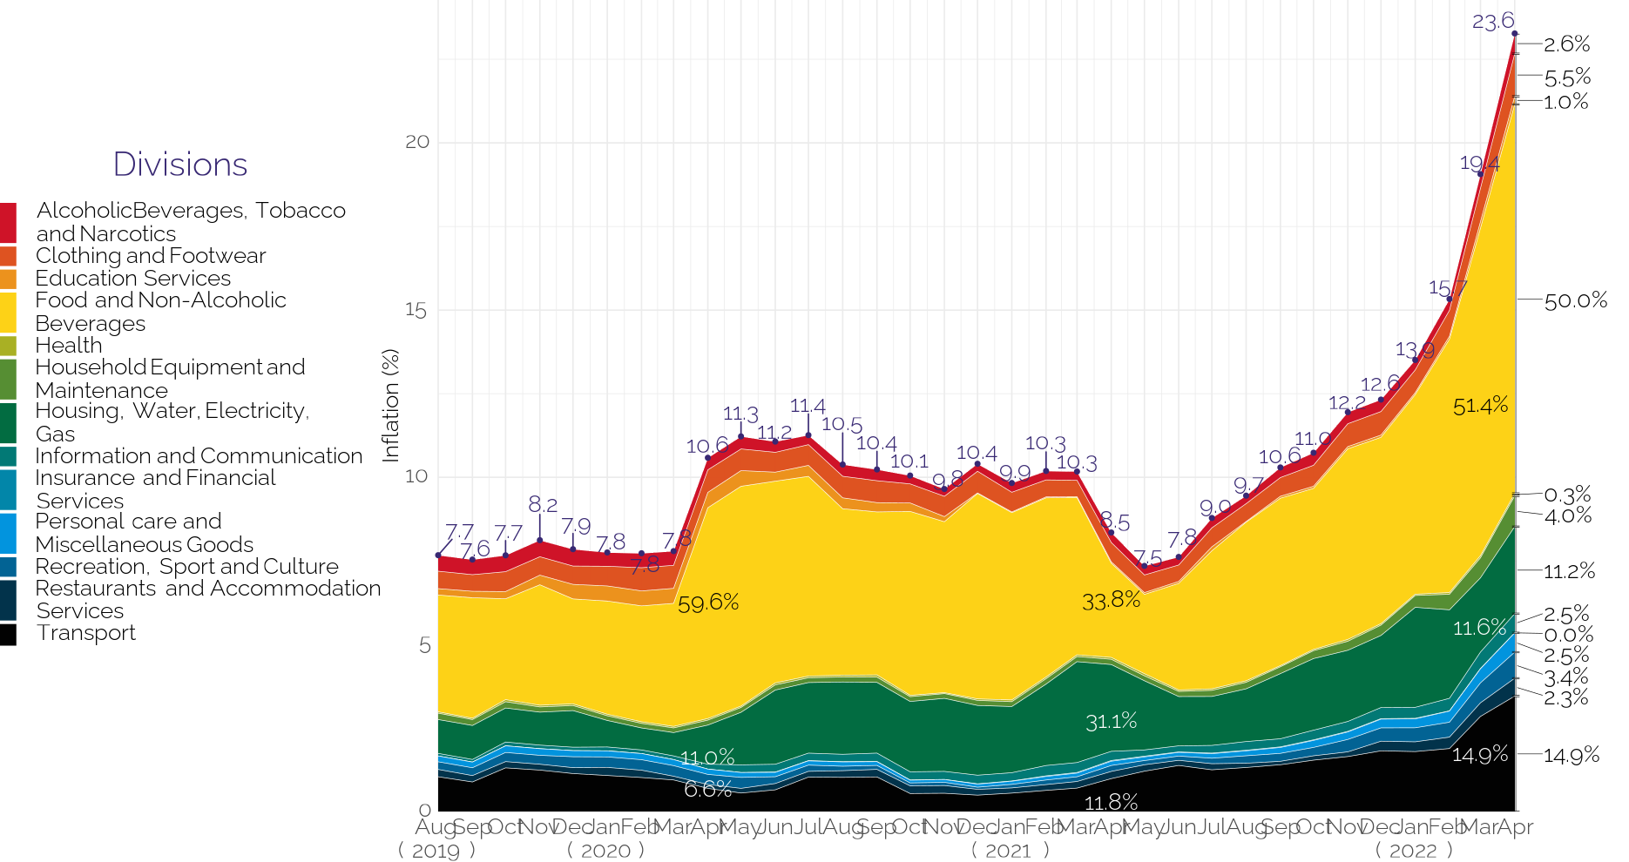
Contribution of year-on-year inflation
9
Notes:
Household Equipment and Maintenance recorded the highest upward change (0.9 percentage points) in the relative contributions of the 13 divisions to inflation rate for April 2022. While the contribution of Transport remained the same (14.9%) for March and April 2022, Food and Non-Alcoholic Beverages and Housing, Water, Gas and Electricity saw a respective reduction of 1.4 and 0.4 percentage points.

Slide 11
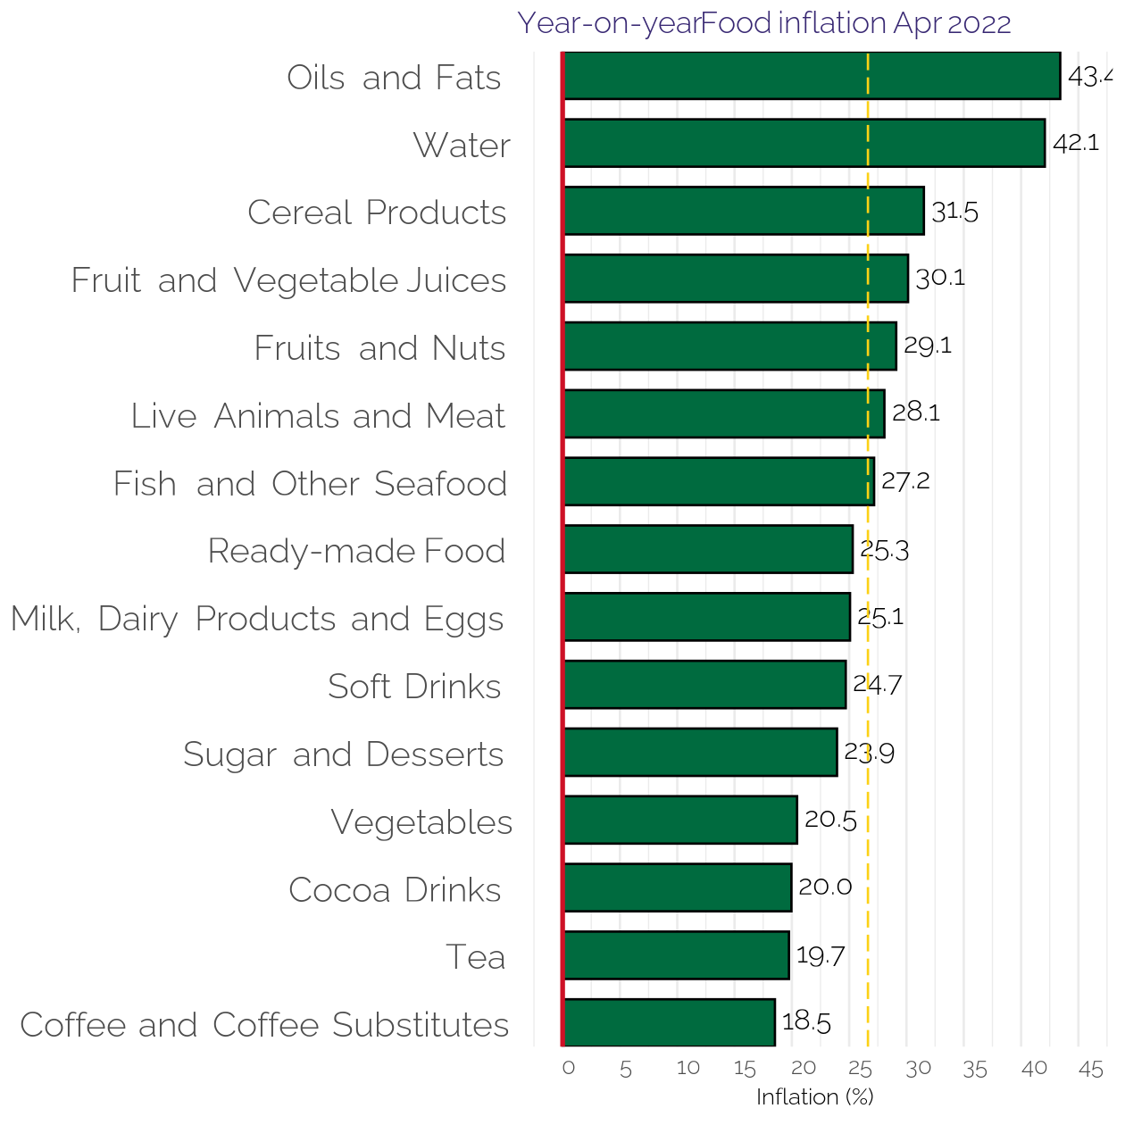
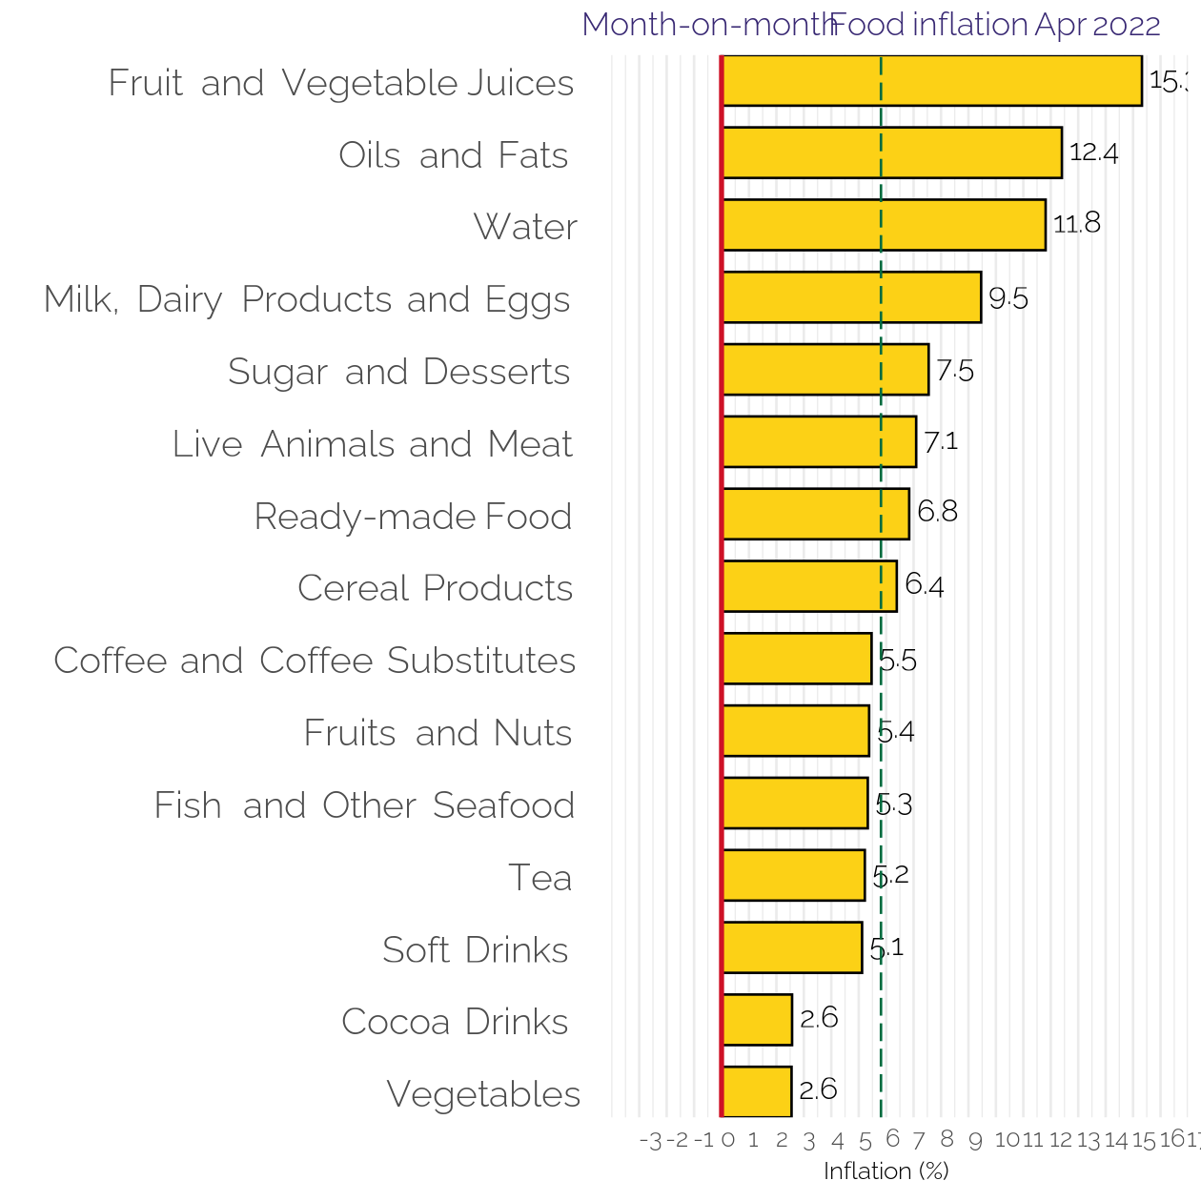
Disaggregation of YoY and MoM Food-inflation by Subclass
10
Notes:
Focusing on year-on-year food inflation for April 2022, seven sub-classes record inflation rates higher than the overall food inflation (26.6%). This was distantly led by Oils and Fats (43.2%) followed closed by Water (42.1%).
On a month-on-month basis, eight sub-classes recorded inflation rates higher than the overall inflation (5.8%). This was distantly led by Fruit and Vegetable Juices (15.0%) followed by Oils and Fats (12.4%) and Water (11.8%)

Slide 12
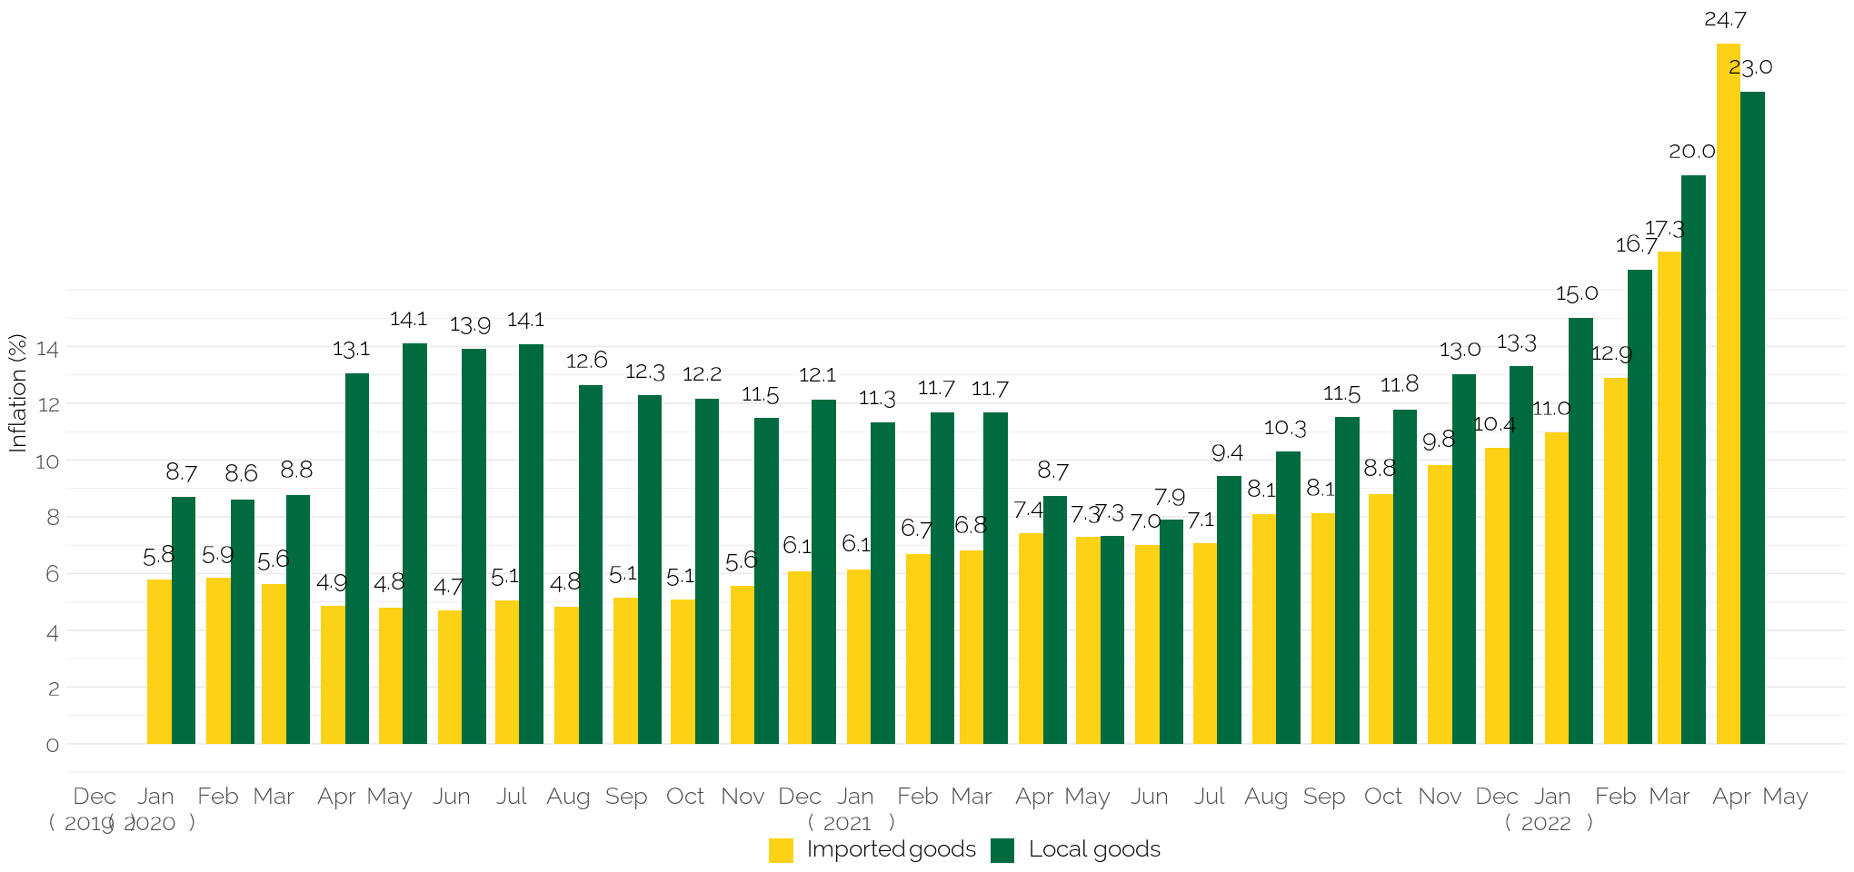
Imported and local inflation January 2020 – April 2022
Notes:
The inflation for imported goods was 24.7% (which is higher than the 17.3% recorded for March 2022) while the
inflation for locally produced items was 23.0% (up from the 20.0% recorded in March 2022).
This is the first time in 29 months that inflation for imported items exceeded domestic inflation.

Slide 13
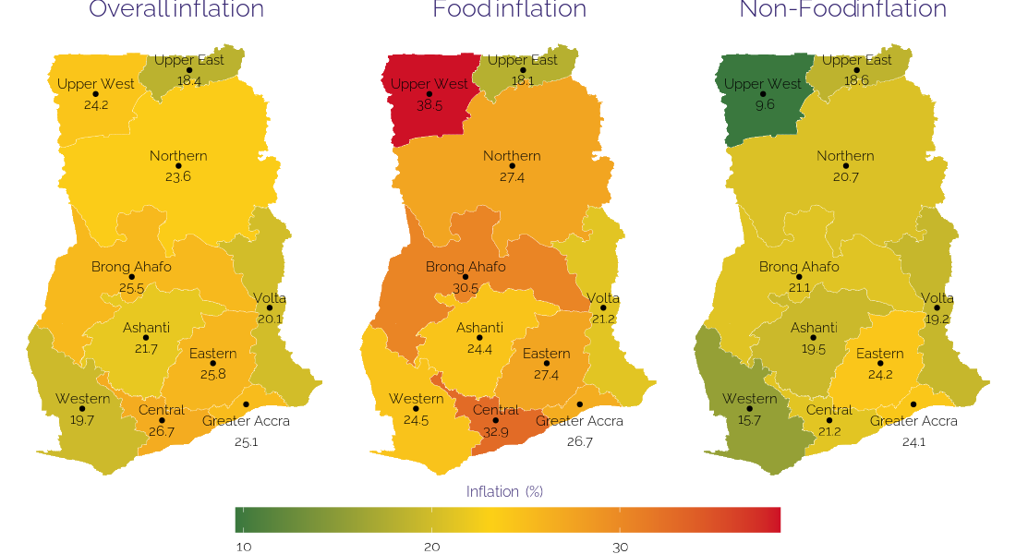
April 2022 regional rates of inflation
12

Slide 14
Disaggregation of inflation in Central & UW Regions for April 2022
13

Slide 15
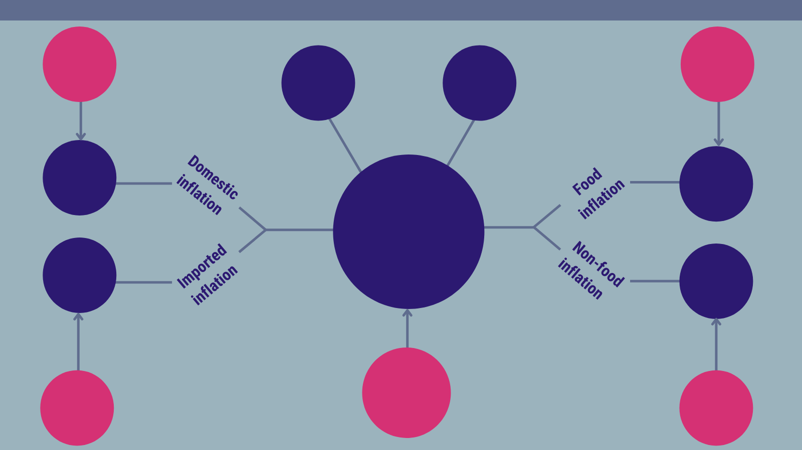
Highlights
20.0%
Domestic inflation
March 2022
22.4%
Food inflation
March 2022
26.7%
Highest regional inflation rate
(Central)
18.4%
Lowest regional inflation rate
(Upper East)
23.0%
26.6%
23.6%
Year-on-year inflation
April 2022
24.7%
21.3%
19.4%
Year-on-year inflation
March 2022
17.3%
Imported inflation
March 2022
17.0%
Non-food inflation
March 2022

Slide 16
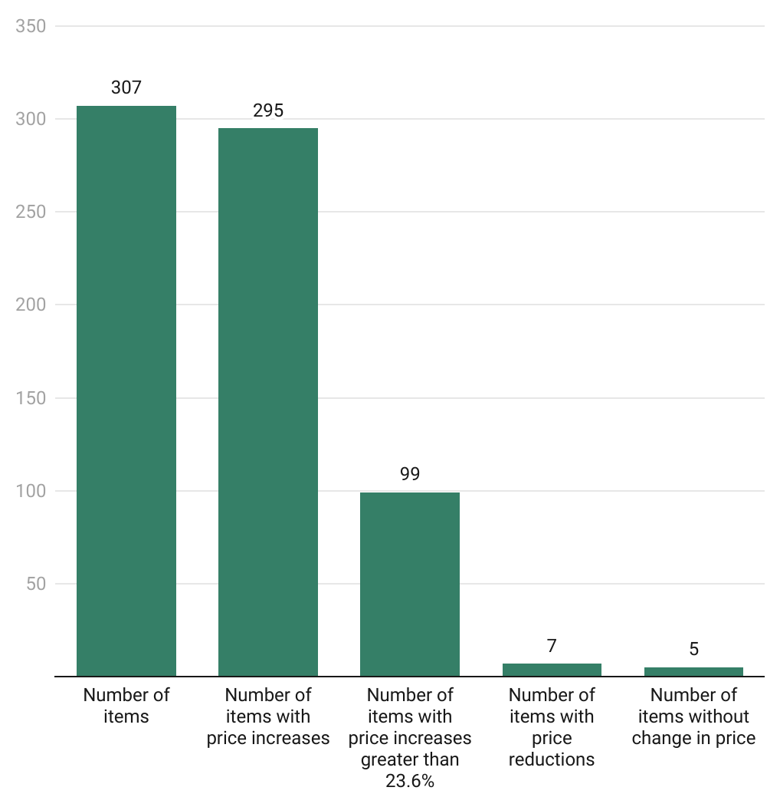
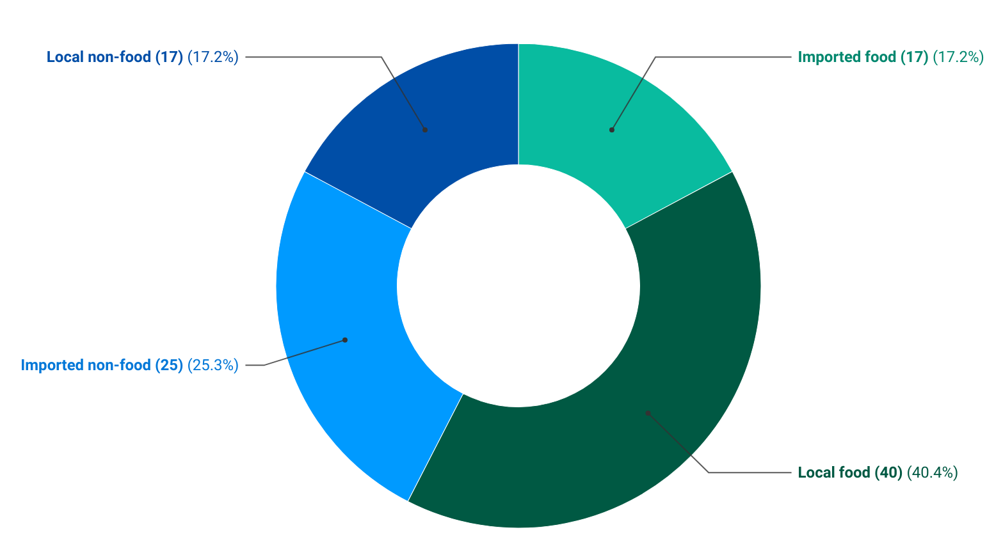
Additional Policy Considerations (1/2)
15

Slide 17
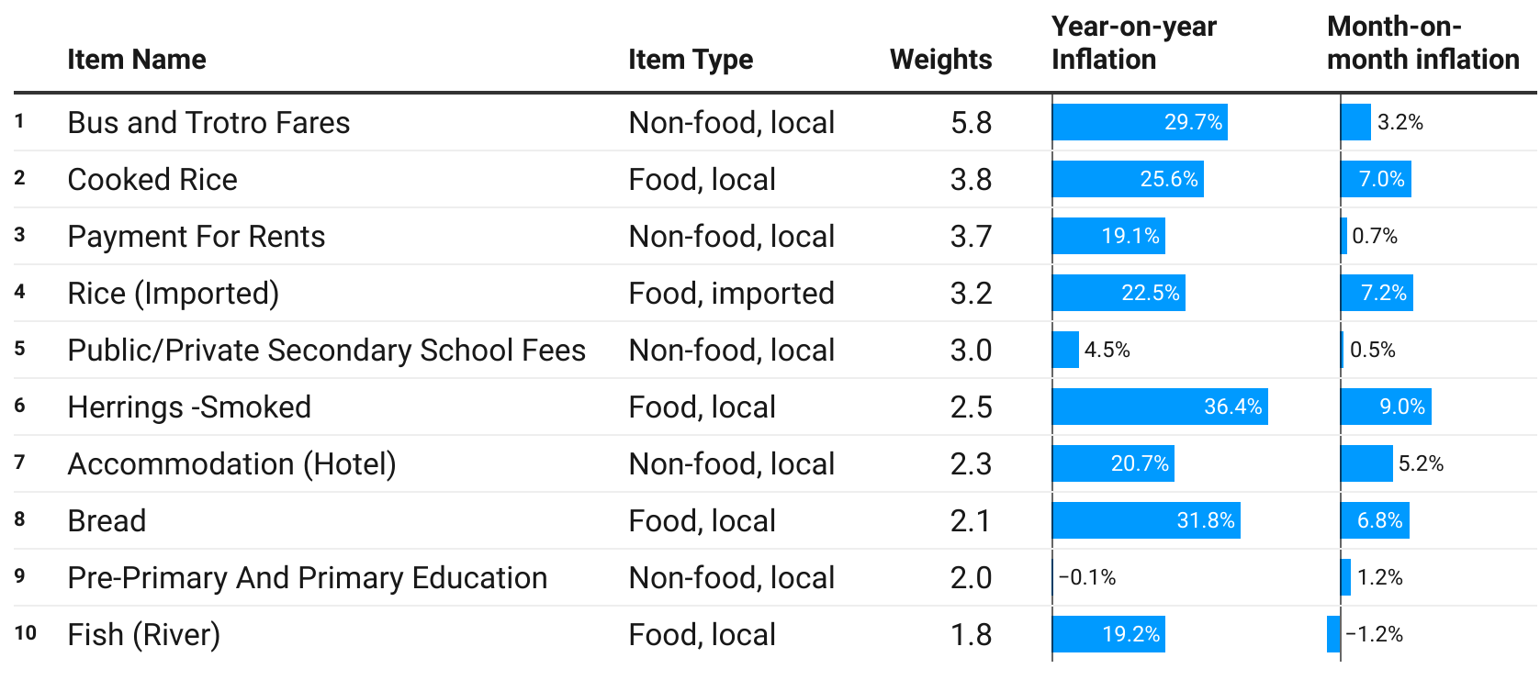
Additional Policy Considerations (2/2)
16

Slide 18
Additional Pointers for Household Decision Making (1/2)
The inflation rates recorded each month have differential impacts on household depending on the basket of items purchased by each household.
Given households’ taste, disposal income and availability of alternatives, the basket of items purchased can be varied in response to the soaring prices.
Top fifteen items with the highest upward change in year-on-year inflation rates for April 2022.
No | Item Name | Item Type and Source | Inflation
1. | Grapes | Food, Imported | 101.9
2. | Diesel | Non-Food, Imported | 90.9
3. | Avocado Pear | Food, Local | 89.2
4. | Petrol | Non-Food, Imported | 73.5
5. | Bushmeat | Food, Local | 66.9
6. | Water Melon | Food, Local | 64.7
7. | Solid Fuels (firewood) | Non-Food, Local | 63.6
8. | Okro (Fresh) | Food, Local | 62.5
9. | Corn Dough/Corn Flour | Food, Local | 54.1
10. | Maize | Food, Local | 52.7
11. | Mango | Food, Local | 52.5
12. | Millet | Food, Local | 52.3
13. | Gas | Non-Food, Imported | 51.1
14. | Wheat Flour | Food, Local | 49.5
15. | Bambara Beans | Food, Local | 49.4
17

Slide 19
Additional Pointers for Household Decision Making (2/2)
Top fifteen items with the highest upward change in month-on-month inflation rates for April 2022.
Ten items on a month-on-month basis recorded inflation rates at least 3 times as the national rate (5.1%).
No | Item Name | Item Type and Source | Inflation
1. | Diesel | Non-Food, Imported | 23.5
2. | Traditional Beer (Pito) | Non-Food, Local | 19.1
3. | Sausage | Food, Imported | 18.9
4. | Millet | Food, Local | 18.3
5. | Mineral Water (bottle) | Food, Local | 17.6
6. | Imported Wine | Non-Food, Imported | 16.9
7. | Washing Soap | Non-Food, Imported | 16.4
8. | Oranges (Fruit) | Food, Local | 16.1
9. | Cement Blocks | Non-Food, Local | 15.5
10. | Fruit Juice | Food, Imported | 15.3
11. | Banana | Food, Local | 14.6
12. | Groundnut Oil | Food, Local | 14.5
13. | Petrol | Non-Food, Imported | 13.5
14. | Vegetable Oil | Food, Local | 13.5
15. | Pawpaw | Food, Local | 12.9
18

Slide 20
End of Press Release for April 2022 Consumer Price Index
For enquiries, please contact:
https://statsghana.gov.gh/gssmain/fileUpload/Price%20Indices/CPI_Technical_Guide_v5_Published_14102020.pdf
Mr. John F.K. Agyaho
(Head, Price Statistics, GSS)
john.agyaho@statsghana.gov.gh

Slide 21
Consumer Price Index and Inflation
April 2022

